Slide 1
HR M&A Integration
Launch
Aligning governance, culture, and change management before
integration planning begins.

Slide 2
Content
Governance
Culture
Governance Process
Governance Structure Covers All Levels
List of Key Decisions Per Process
Criteria to Allocate Authority
Decision Matrix
Values & Behaviors
Actions to Change Culture
Trade Offs
Communication
Change Management
Establishing Feedback Loops
Change Management Activities
Roll-out a Transition Management Toolkit
Building Cross-Organization Relations
© 100-Day Advisors MandAPlaybook.com

Slide 3
Integration Priorities
Global
Local
Vision, Operating Framework and Leadership Alignment:
Communication and Feedback Loops:
Define a shared vision including business model, governance, processes, roles & responsibilities, Measurements and align leadership around them
Establish a communication plan and local feedback loops
Culture:
Staffing:
Define new Values, assess current cultures and create culture integration plan
Define and implement clear staffing principles and process
HQ:
Transition Management: :
Create and implement a change management plan for the move
Roll-out a Transition management toolkit to support employees to adapt to change and deal with culture clash
© 100-Day Advisors MandAPlaybook.com

Slide 4
1st Draft of Integration Timeline (1/2)
Milestone
Apr
May
Jun
Jul
Activities
14
15
16
17
18
19
20
21
22
23
24
25
26
27
28
29
Vision and Operating Framework
  Strawman list of committees and decisions
  Prepare and schedule SEC interviews
  Conduct Exec Co. members interviews
  Run Exec Co. workshop
  Organize and run Leadership Workshop
  Communicate/cascade down
Culture
  Define Values (Exec Co.)
  Validate Values in Leadership Workshop
  Establish priority countries and assess cultures
  Define and implement culture integration action plans
© 100-Day Advisors MandAPlaybook.com

Slide 5
1st Draft of Integration Timeline (1/2)
Milestone
Apr
May
Jun
Jul
Activities
14
15
16
17
18
19
20
21
22
23
24
25
26
27
28
29
Creation of HQ (Task Force)
  Articulate business case, future state, behaviors expected
  Design and implement communication plan
  Create and implement “ritual” events
  Establish feedback loops
Country feedback loops (Communication)
  Select countries and identify focal point
  Conduct focus groups
  Compile monthly feedback to Exec Co.
Transition Management
  Select countries and identify workshop facilitators
  Create workshop toolkit
  Train facilitators
  Roll-out workshops
© 100-Day Advisors MandAPlaybook.com

Slide 6

Governance

Slide 7
Governance Process
Purpose:
Resources needed:
Establish Vision, Values and Governance (Decision Committees) and define roles and authority for each key decision
Align leadership around this framework
Process:
Exec Co. availability for interviews + workshop
Budget for off-site leadership workshop
Activity
When
Define strawman list of governance committees and key decisions per process
Interview Exec Co. members to collect their input on vision, values, governance committees, key decisions and criteria to allocate authority
Compile a strawman to be discussed at workshop
Conduct an Exec Co. workshop to agree on vision, values and decision matrix
End Apr/Beg May
Conduct a leadership workshop (Exec. Co. and direct reports) to agree on vision, values, governance, decision making and target setting
June
© 100-Day Advisors MandAPlaybook.com

Slide 8

Culture

Slide 9


Culture
Purpose:
Process:
  Identify the values that will make NewCo successful in the future and have the values embedded in the way employees work and make decisions
  Step 1: Values definition (together with Vision and Operating Framework)
    Create new Values in an Exec Co. workshop
    Validate values with a broader leadership group at leadership workshop
  Step 2: Culture assessment
    Select countries/companies for culture assessment
    Assess current cultures using focus groups (HR function to support this step)
  Step 3: Action plan
    Design and implement a set of actions to lead employees to the desired culture
© 100-Day Advisors MandAPlaybook.com

Slide 10
Values & Behaviors
Results driven
Leadership
Commitment/Self-discipline
Can be relied upon to exceed targets successfully
Does better than competition
Pushes self & others for results while staying in bounds of ethical and legal standards
Establishes clear directions and sets stretch objectives
Aligns and energizes associates behind common objectives
Rewards/encourages the right behaviors and corrects others.
Fully supports and implements decisions
Is 100% committed to achieve agreed-upon targets (strives to achieve the "slightly impossible")
Pursues targets with a need to finish. Does not give up, especially in the face of adversity.
Customer / Quality Focus
Fast/Action-oriented/Initiative/Simplicity
Mutual Respect/Candor/Trust/Integrity/Loyalty
Assigns highest priority to customer satisfaction
Listens to customer & creates solutions for unmet customer needs
Establishes effective relationships with customers and gains their trust & respect
Is action-oriented & full of energy to face challenging situations
Is decisive, seizes opportunities and ensures fast implementation
Strives for simplicity & clarity. Avoids “bureaucracy”
Establishes mutual respect and trust in dealing with others
Acts and behaves in accordance with his/her words
Commits to honesty/truth in every facet of behavior and demonstrates ethical and legal conduct
Keeps confidences, admits mistakes & does not misrepresent self for personal gain
Innovative & Creative
Empowerment/Accountability
Open Communication/Collaboration/Compassion
Comes up with a lot of new & unique ideas
Challenges “status-quo”: does not settle for the first right idea
Makes new connection work by seeing relationships between seemingly disconnected elements, synthesizes odd combinations
Sets clear performance targets and a well defined "playing-field" with corresponding personal accountability
Defines clear-cut, flexible involvement process (involves the right associates in the right situation at the right time)
Fully utilizes diversity of team-members to achieve superior business success
Shares consequences of results with all involved
Fully cooperates with all organizational compliance initiatives and legal requests, as well as motivates others to behave in a way that ensures adherence to the same.
Communicates in open, clear, complete, timely, and consistent manner
Listens effectively and invites response
Genuinely cares for people & demonstrates empathy
Is a team player
Competent
Has functional & technical knowledge & skills to successfully perform his/her role
© 100-Day Advisors MandAPlaybook.com

Slide 11
Actions to Change Culture
  A compelling positive vision: clear behavioral expectations and their link to business performance
  Talent Management: hiring and promoting people taking the values in consideration; demoting or letting go people that consistently do not fit the culture desired
  People Development: Formal training, practice fields, coaches and feedback
  Positive role models: leadership to role model behaviors; 360 feedback
  Consistent systems, processes and structures: design systems, processes and structures that reflect the values (e.g., Lean structures and simple processes if speed is a value)
© 100-Day Advisors MandAPlaybook.com

Slide 12
Tradeoffs
  Decentralized Operations vs. Global Leverage
  Speed/Flexibility vs. Control/Reports
  Entrepreneurship/Risk Taking vs. Compliance
  People Selection vs. Demotion
© 100-Day Advisors MandAPlaybook.com

Slide 13

Communication

Slide 14
Establishing Feedback Loops
Purpose:
  Create continuous improvement and learning by informing decision makers at local and global levels of the associates‘ feedback
Process:
Activity
When
Who
Select priority countries for feedback collection
Get buy-in from senior management and country heads for the concept and roll-out model
Country Heads identify a local country focal point (e.g., Communication or HR) to conduct monthly randomly selected focus groups (or interviews/survey when geography makes it difficult to bring people together)
Provide these country focal points with a process for people selection, conducting the focus groups and reporting feedback
Conduct focus groups and collect the feedback
Present the feedback at local executive level
Conduct monthly phone call with all country points to discuss feedback at global level
Compile feedback and present to Exec Co.
Resources needed:
  Network of local country focal points with skills and time to implement focus groups and feedback compilation,
  20% FTE at HQ to support the process

Slide 15

Change Management

Slide 16
Change Management Activities
Activity
When
Who
Articulate business case and project scope, future state/importance of change/success measures and establish umbrella behaviors/attitudes required at HQ
Identify a change team including communication expert, line manager and events organizer, familiar with the new HQ
Design and implement a communication plan, focused on both individuals and group
Communication team
Create rituals:
Mourning
Celebration (e.g., launch, mentoring to newcomers, quick wins, rewards)
Change Team
Establish feedback loops (e.g., bi-weekly departmental meetings)
Change and Comm. Team
© 100-Day Advisors MandAPlaybook.com

Slide 17



Roll-out a Transition Management Toolkit
Purpose:
Process:
Resources needed:
  Support associates through the transition in adapting to change and easing the culture clash, reducing the recovery time to a minimum
  Select priority countries that are going to go through transition
  Get buy-in from senior management and country heads for the concept and roll-out model
  Country heads appoint a local country representative
  Provide a local country representative (e.g., Communication or HR) with a workshop facilitator toolkit including different options of delivery and train them on how to apply it
  Local country representative with country head decide what is best for their country and implement
  Network of local country representatives with skills and time to organize and deliver workshops
© 100-Day Advisors MandAPlaybook.com

Slide 18
Strengthen Cross-Organization Relations
  Show respect for the other side. Be humble. Ask, don’t demand.
  Acknowledge potential defensiveness. Diffuse it with diplomacy.
  Communicate a positive, upbeat outlook: together building a new organization.
  Teach them what works in your organization and learn from them what works at their organization.
  Don’t take for granted everything you hear.
  Don’t assume people understand everything you say.
© 100-Day Advisors MandAPlaybook.com

Slide 19
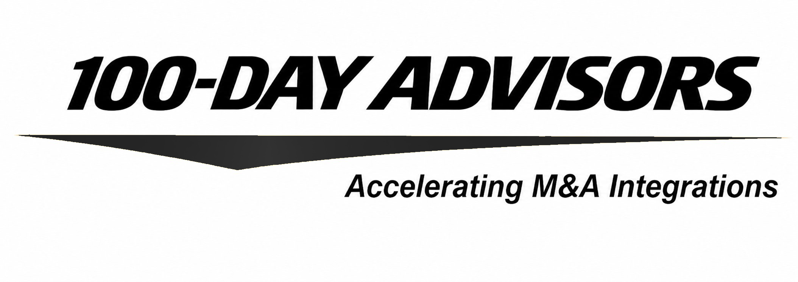


thank you
contact us
email
inquiries@MandAPlaybook.com
website
MandAPlaybook.com/consulting

